Slide 1
ML PROJECT Automatic car classification with AI ALAN BAUZÁ

Slide 2

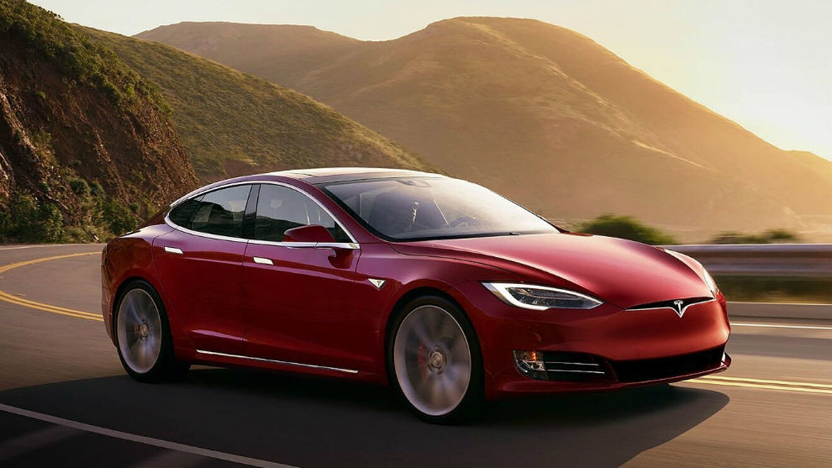
Table of contents
Tesla Model S
Main Deliverables
EDA
Flowchart
Models performance
Next Steps to further improve the results

Slide 3
Main deliverables
Vehicle classifier CNN for make and model for e-commerce
EDA
Pre-processing, data preparation and training scripts
API and basic UI
Containerized with Docker and ready to be deployed
License plate reader
Unit Tests

Slide 4
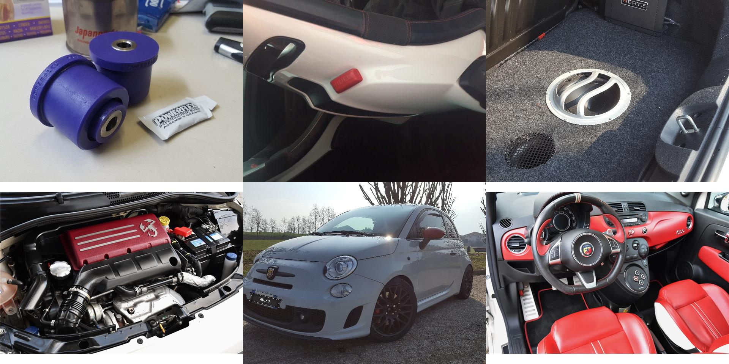
EDA

Slide 5
EDA
Initial dataset 1.6 M images, 57 makes, 837 classes.
Classes imbalance: Range between 67 and 6112 images.
Selected maximum of 300 raw images per class.
1 class with corrupted files.
95.000 images for train (80%) and test (20%).
Added extra images. Went from 91 images per class to 192.

Slide 6
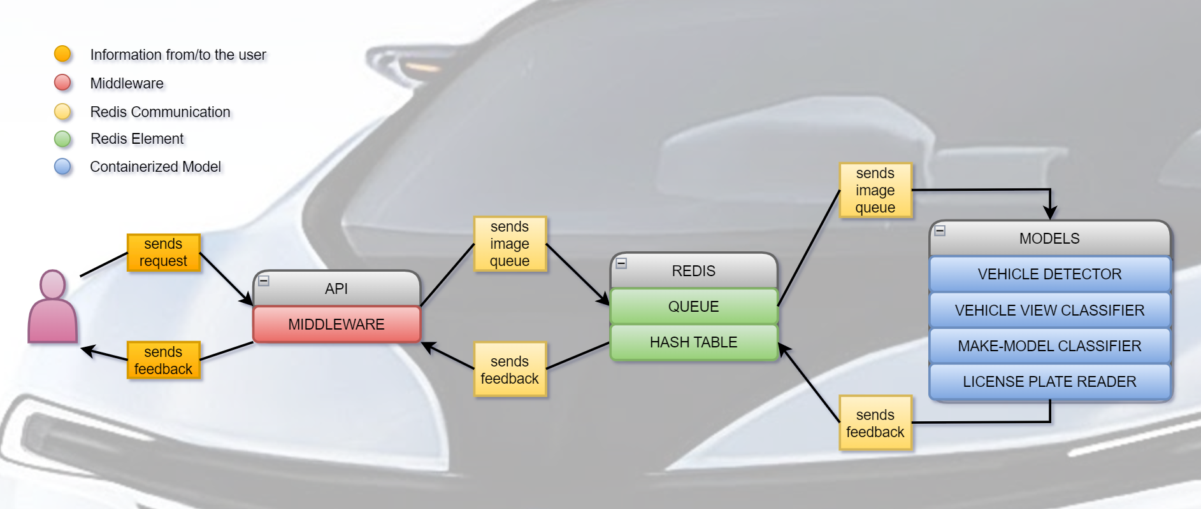
API General Flowchart

Slide 7
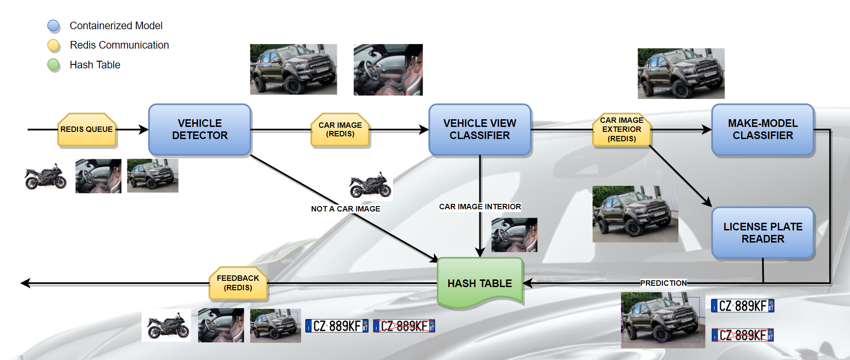
Models Flowchart

Slide 8
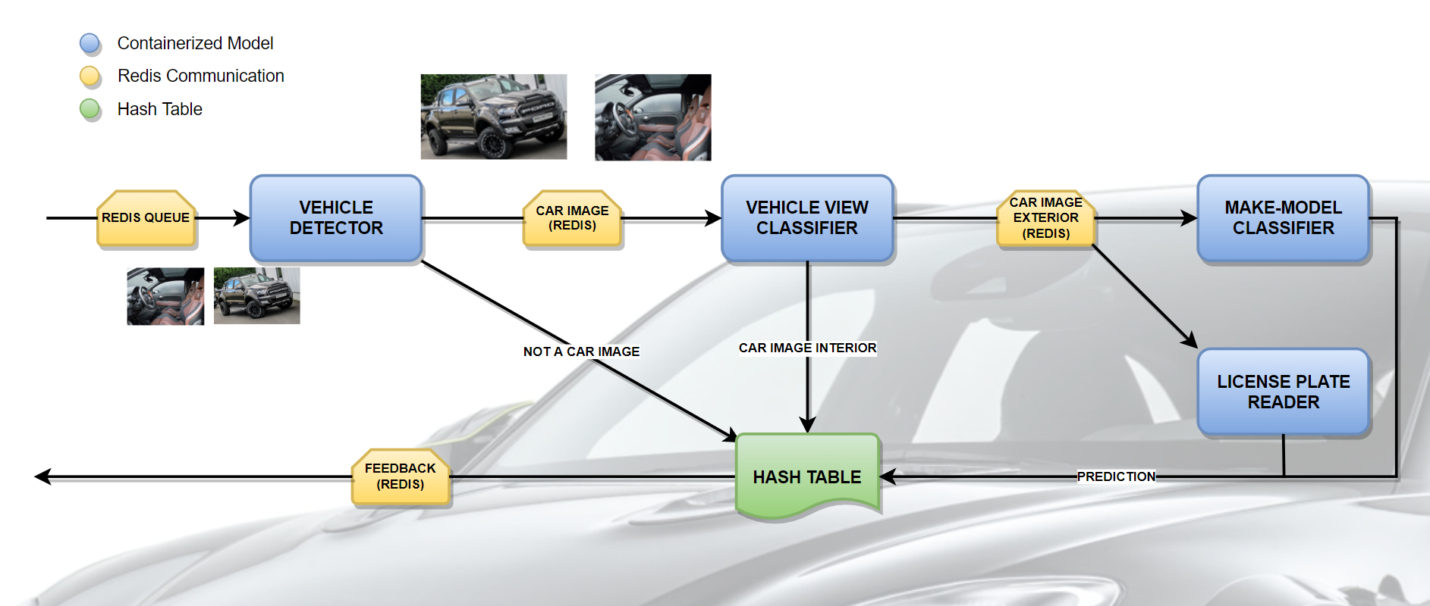
Vehicle Detector Flowchart

Slide 9
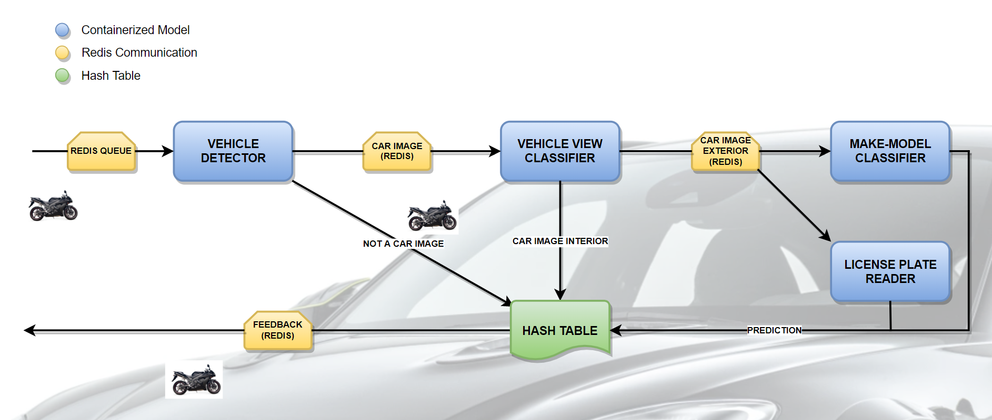
Vehicle Detector Flowchart (cont.)

Slide 10
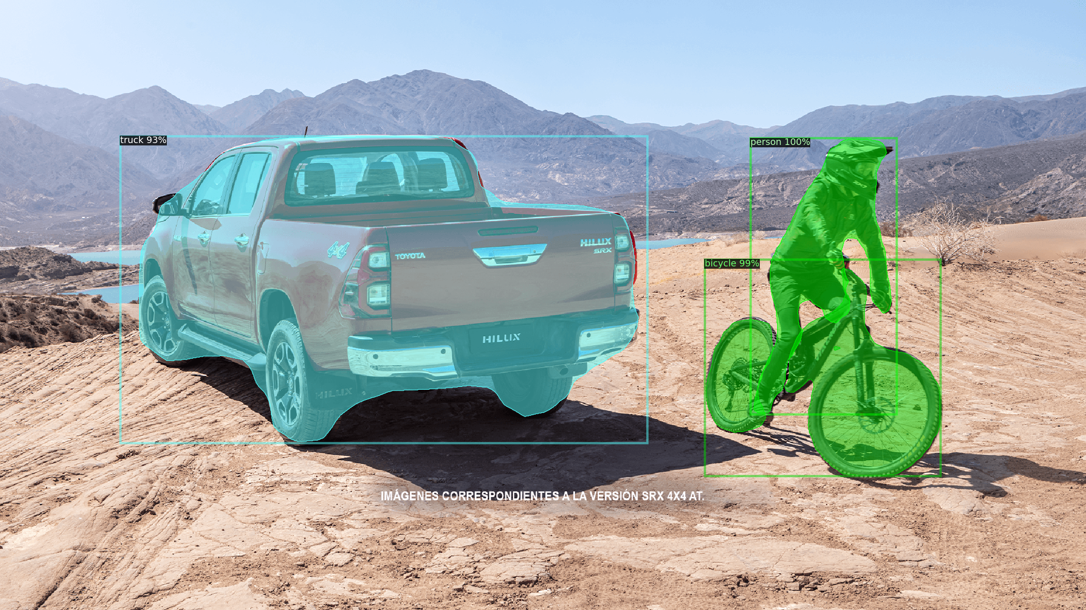
Vehicle Detector

Slide 11
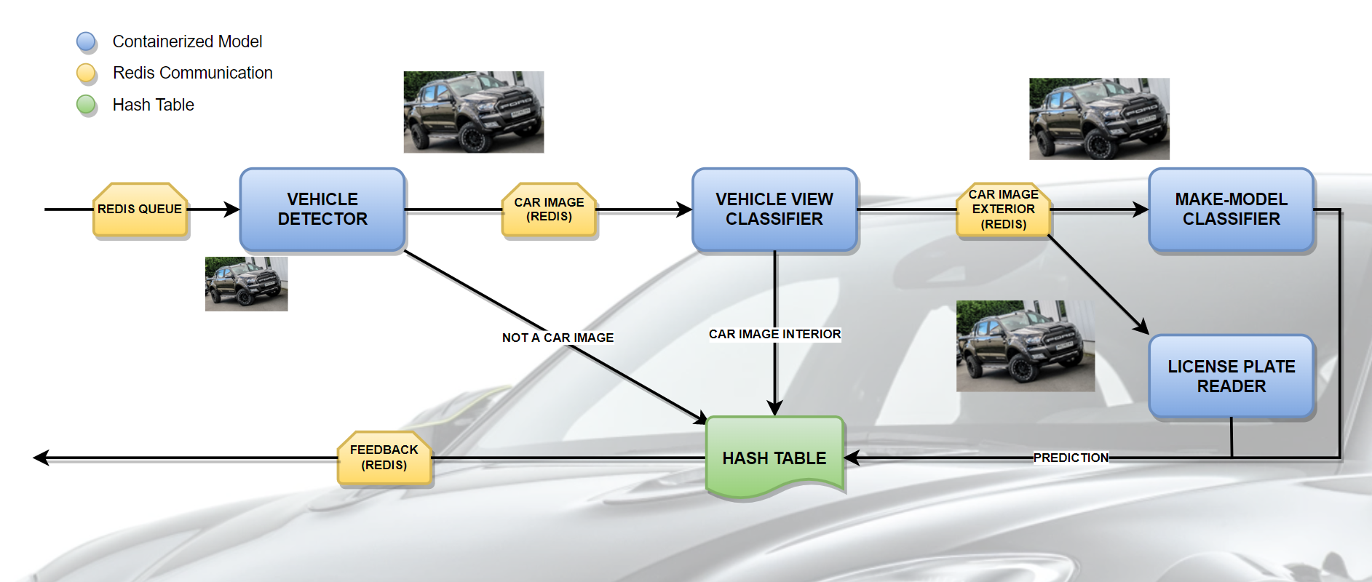
Vehicle View Classifier Flowchart

Slide 12
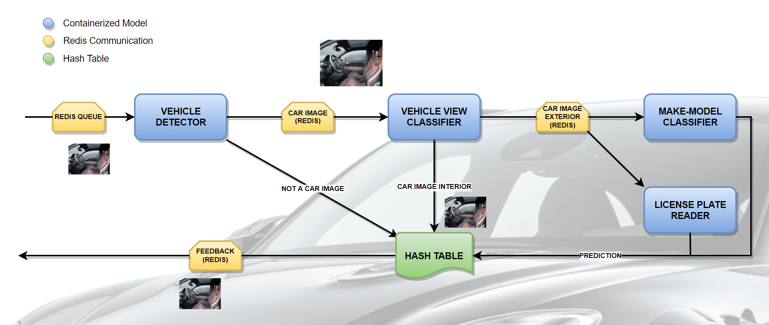
Vehicle View Classifier Flowchart (cont.)

Slide 13
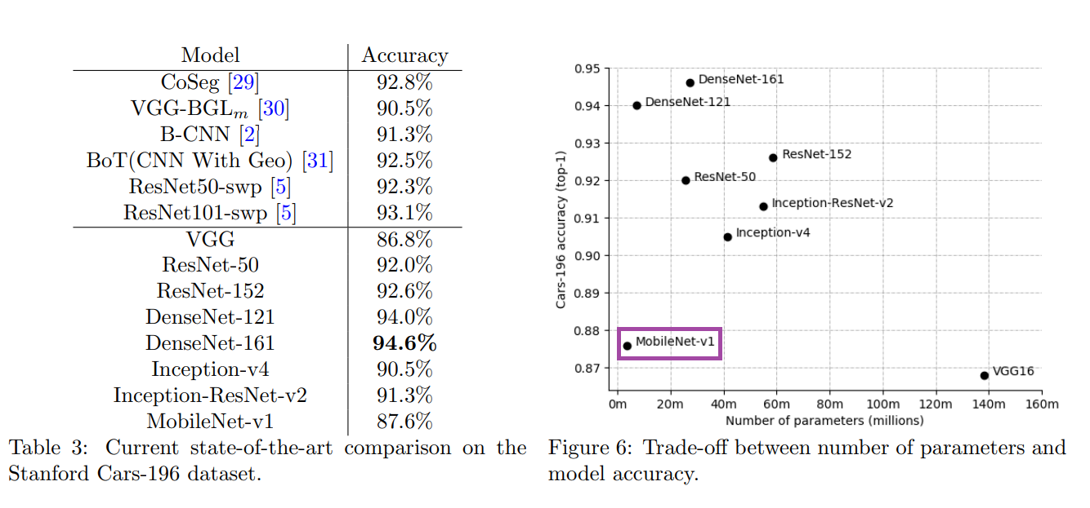
Vehicle View Classifier

Slide 14
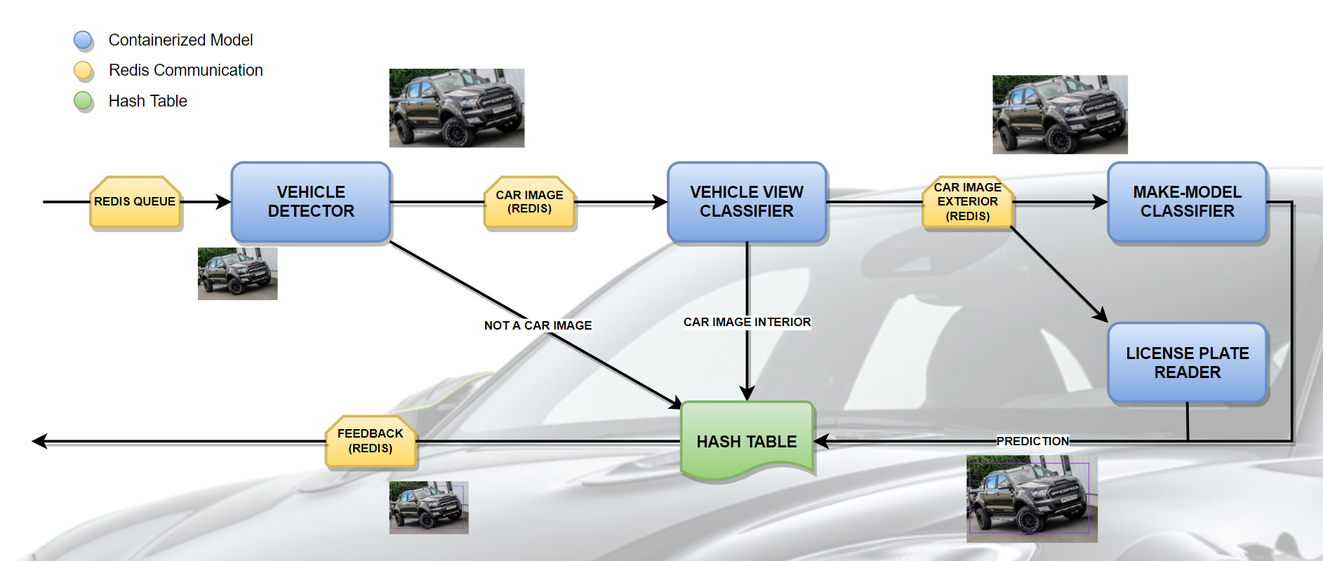
Make-Model Classifier Flowchart

Slide 15
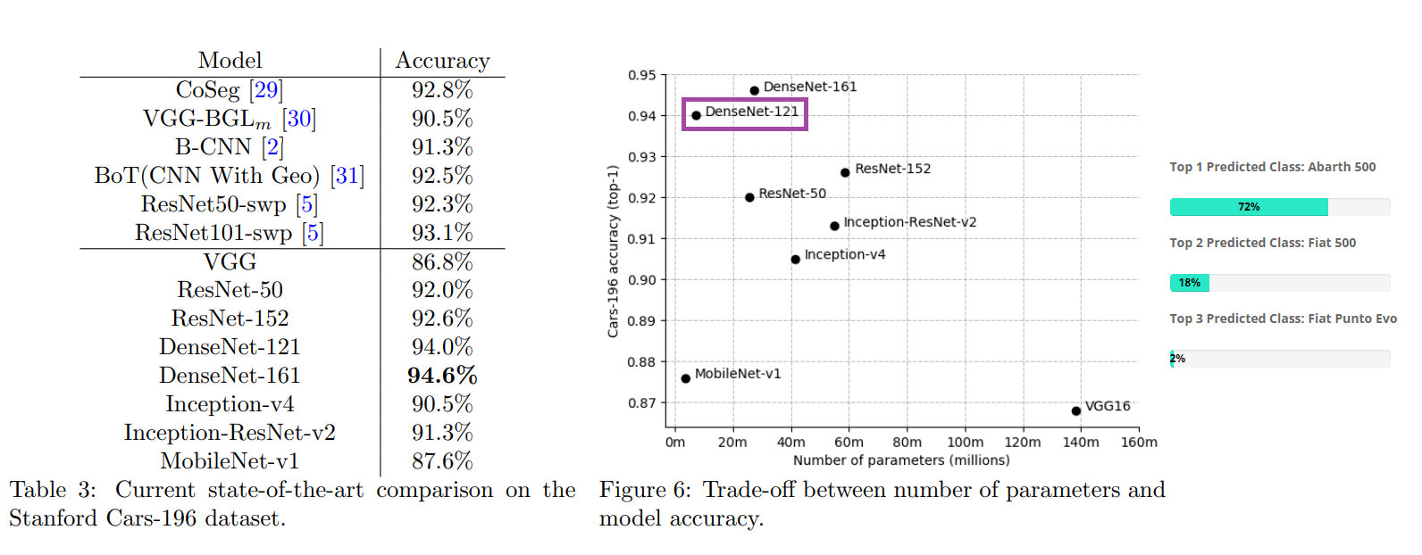
Make-Model classifier

Slide 16
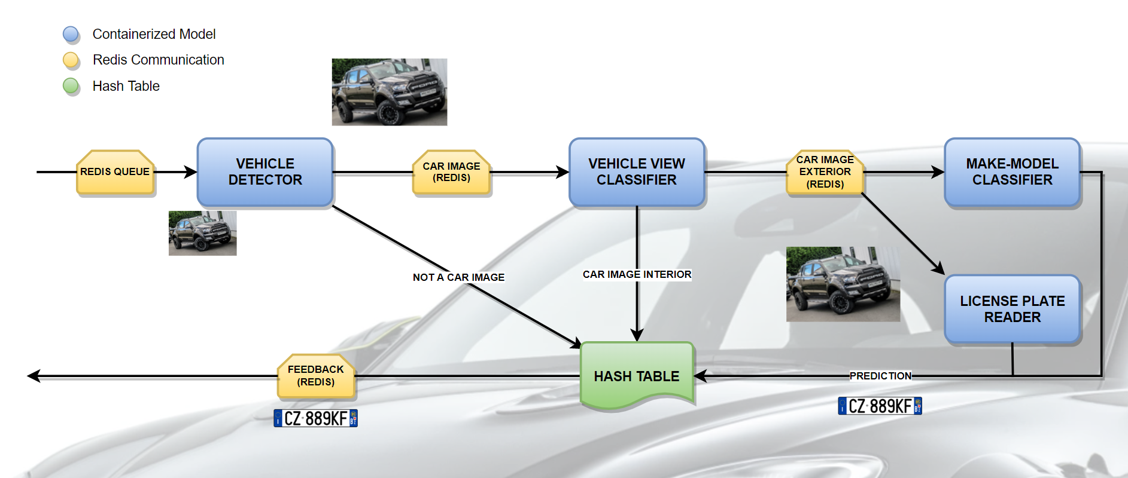
License Plate Reader Flowchart

Slide 17

License Plate Reader Flowchart (cont.)

Slide 18
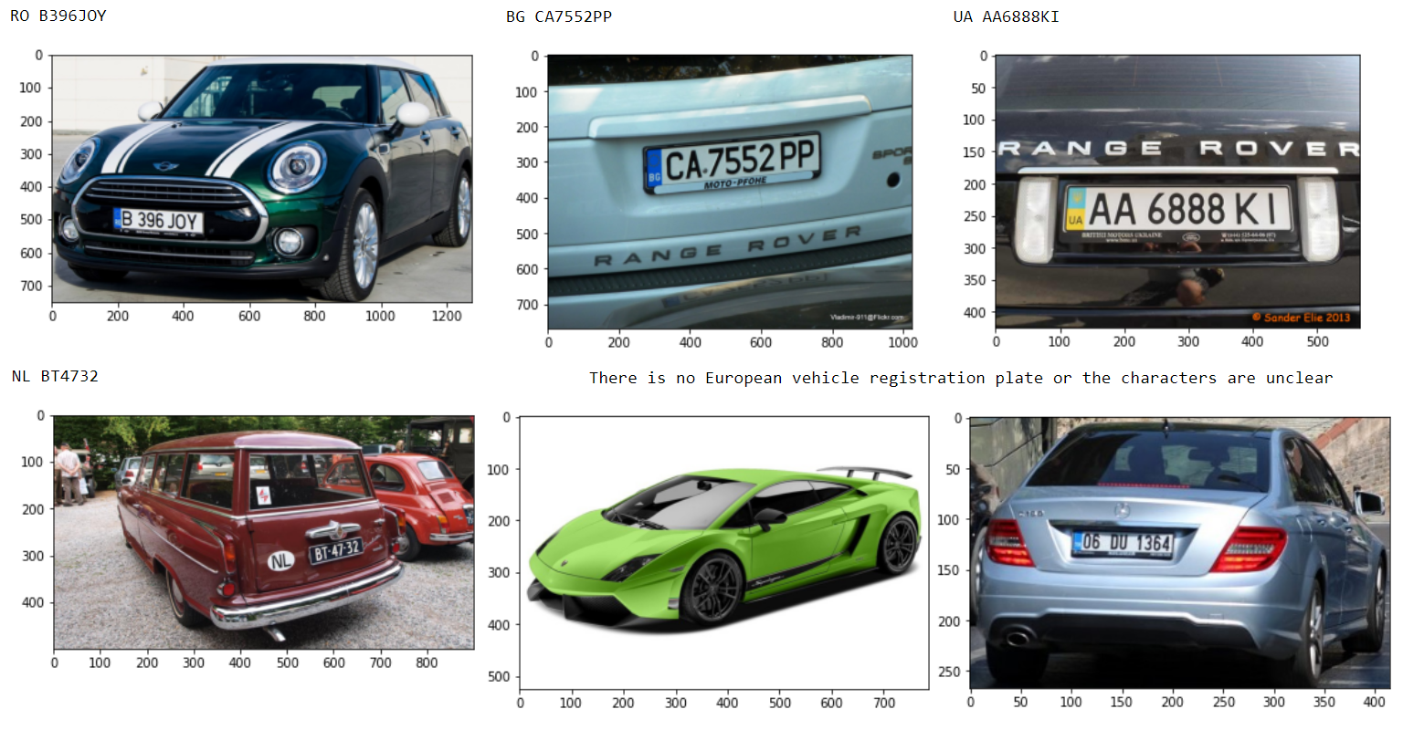
Vehicle Registration Plate Detector

Slide 19
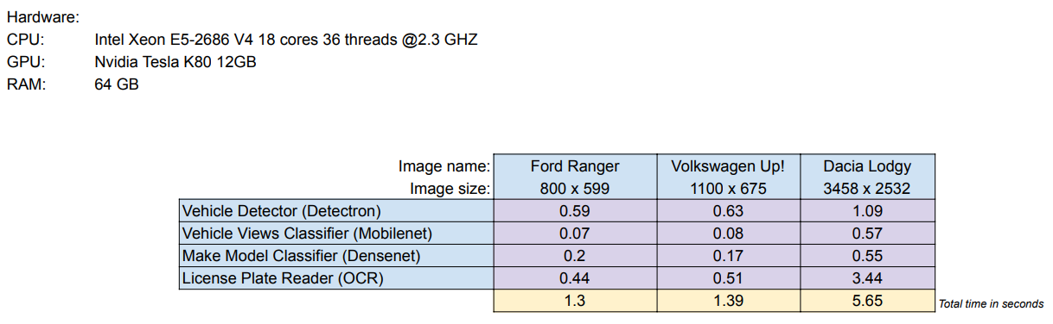
Models time performance according to image size (Using GPU)

Slide 20
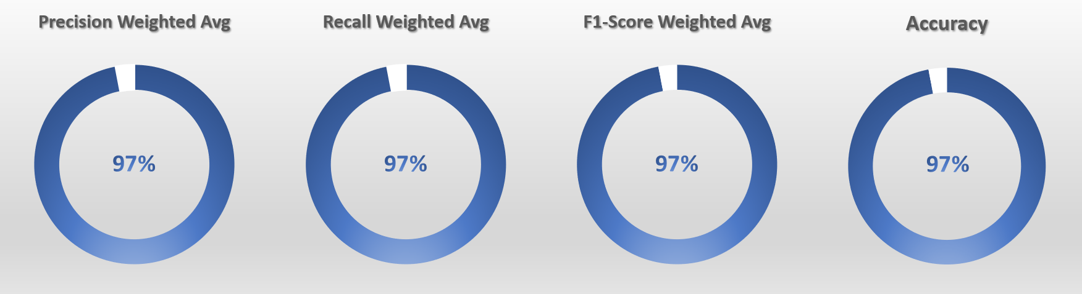
Vehicle View Classifier Test Performance

Slide 21
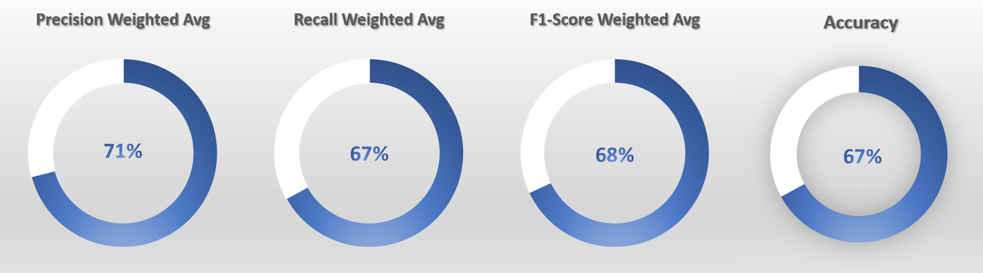
Make-Model Classifier Test Performance

Slide 22
Next steps for future upgrading
Check for more possibilities to merge more car models into the same class.
Gather more images for those underrepresented classes (balance classes).
Add images from all angles: (front, left back, side, etc.).
Script that cleans the uploaded images after a certain time for disk memory efficiency.

